Slide 1
OAuth 2 and ADFS
An ongoing learning process

Slide 2
What is OAuth 2?
OAuth 2 is the next version of OAuth
The most significant thing for me to learn was that OAuth 2, as a specification, does not include authentication
The OAuth 2 spec describes OAuth 2 as an authorization framework that enables limited access to user accounts via an HTTP service. E.g.: Facebook, Twitter, GitHub, etc.)
OAuth 2 describes a service provider (of claims) and a consumer (web site, mobile app, web service, etc.)
An excellent source to describe these is at this URL: https://www.jerriepelser.com/blog/authenticate-oauth-aspnet-core-2/

Slide 3
Enterprise Security
Kerberos/LDAP
SOAP and WS* (WCF)
Or XML and SAML

Slide 4
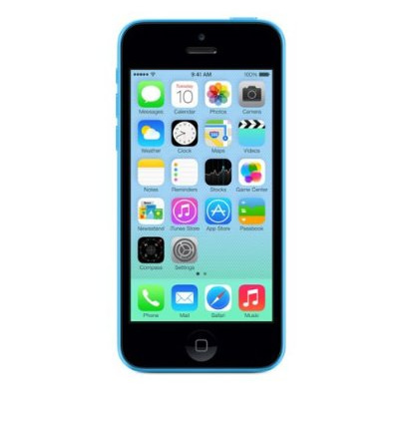
The Mobile Revolution
No SOAP, SAML or WS*
Instead HTTP and JSON
This Photo by Unknown Author is licensed under CC BY

Slide 5
So, How Do You Authenticate?
ASP.NET Identity Server
ASP.NET Core Identity
Open Web Interface for .NET (OWIN)
ADAL.NET
ADFS
Azure AD

Slide 6
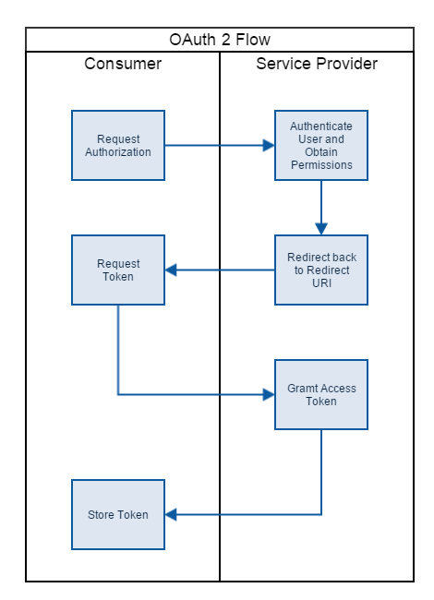
This is from Jerrie Pelser’s blog post

